Slide 1
Click A Job Recruitment System Based Android Mobile apps
Presented by:
Koo Sheng Kuan (168225)
Supervisor:
Assoc. Prof. Dr. Zuriati Binti Zulkarnain

Slide 2
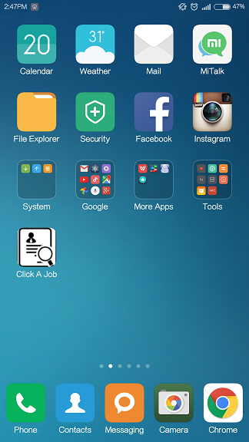
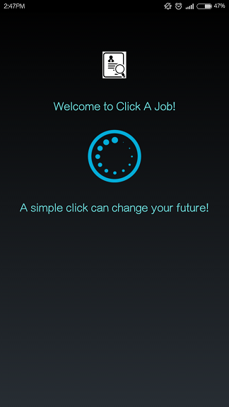

Demonstration
Icon of Click A Job apps
When Click A Job is selected, it runs this loading page for 3 seconds.

Slide 3
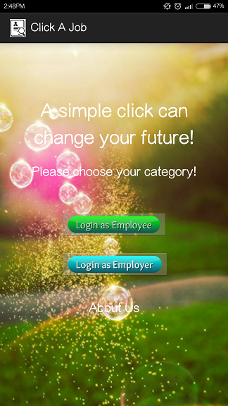
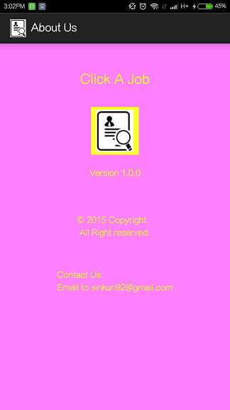
This is the main activity of Click A Job. There are two categories to login as: Employee and Employer.
Before login, you can also see our details when click ‘About Us’.

Slide 4
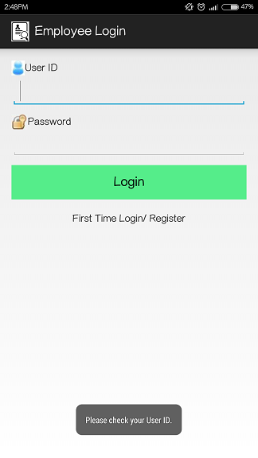
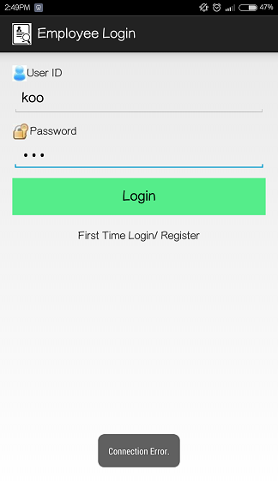
Part 1: Employee
The main interface of employee login.
Click here to register a new account.
If there are no Internet access, whether is connect using Wi-fi or data, it will show ‘Connection ERROR’.
If there are empty in UserID or Password, system will ask for check.

Slide 5
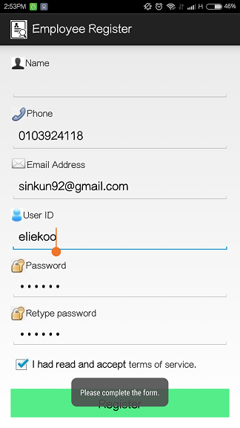
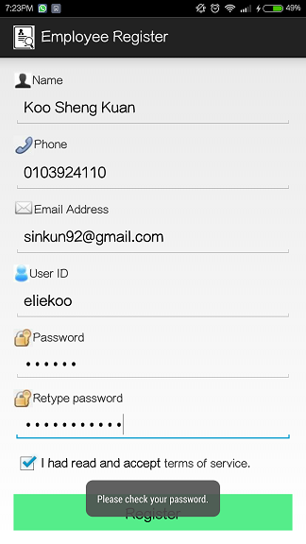
Employee Registration
The main interface of employee register.
If the form is not complete, system will ask for ‘Please complete the form’.
If the passwords are not same, system will ask for ‘Please check your password’.

Slide 6
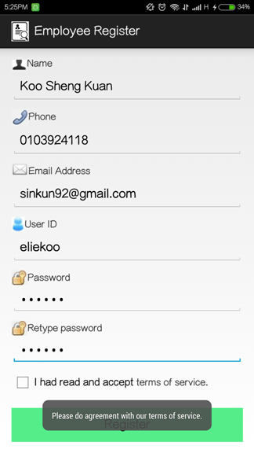
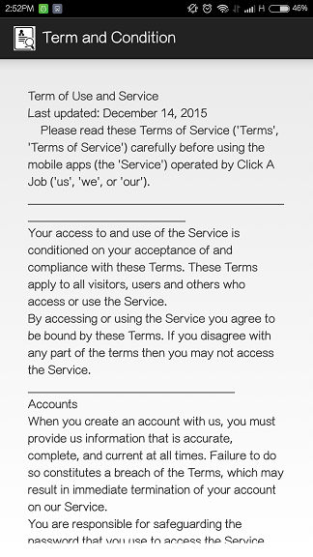
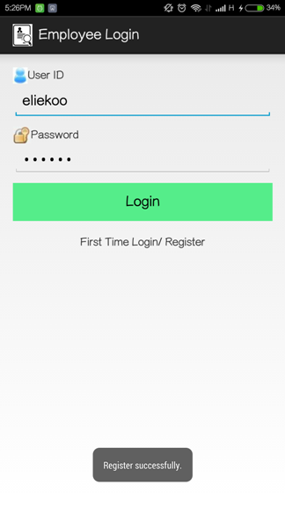
Employee Registration
Term and condition interface.
If new employee didn’t tick for accept ‘term of service’, they will register unsuccessful. They can view the term and conditions by click the ‘terms of service’.
If verification of registration success, a new account had been registered successful and will back to login page with default UserID and Password value which had been registered just now.

Slide 7
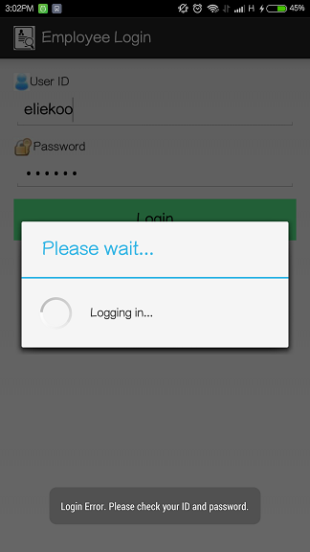
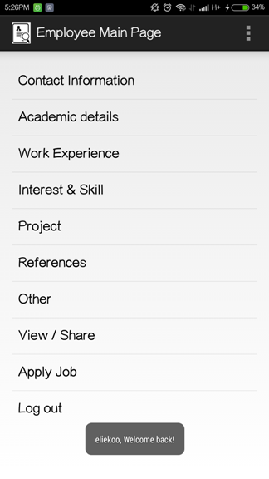
Employee Main Page
The Progress Dialog will shows it’s connecting to server and logging in.
Create & edit CV/ resume
The main interface of employee. When login success, it will shows ‘@user, Welcome back!’
Share CV or apply job
Log out

Slide 8
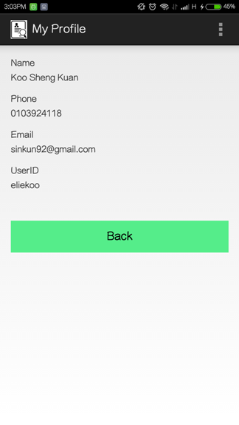
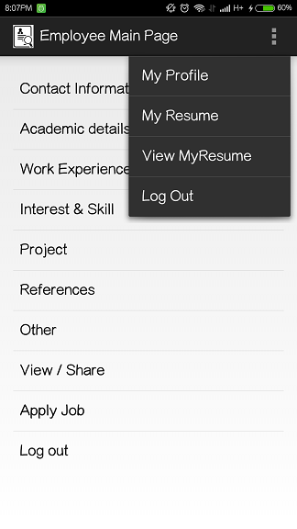
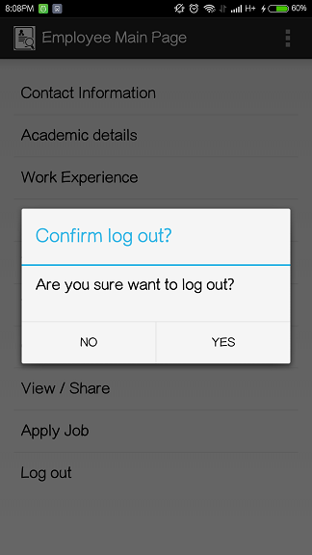
Click ‘My Profile’ to check your details.
The details are same with input of registration.
When logout is selected, Alert Message will come out.
If user’s answer is YES then will back to main activity and loging out user. If NO then logout cancelled.
‘View MyResume’ here same with ‘View / Share’ in the ListView.

Slide 9
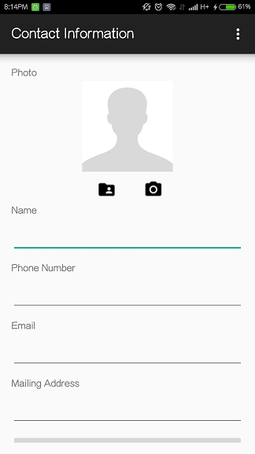
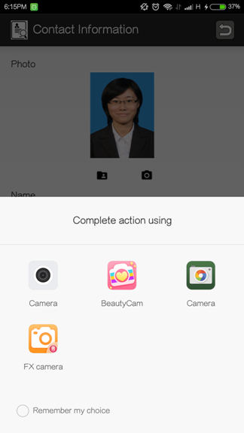
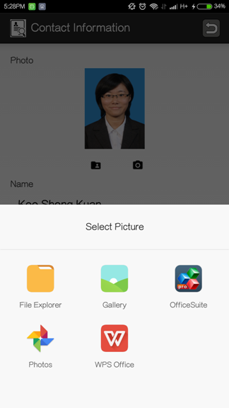
Create resume FIRST step: Contact Information
Click this to take a photo. (Using front or back camera)
Click here to select picture that currently saved in phone.

Slide 10
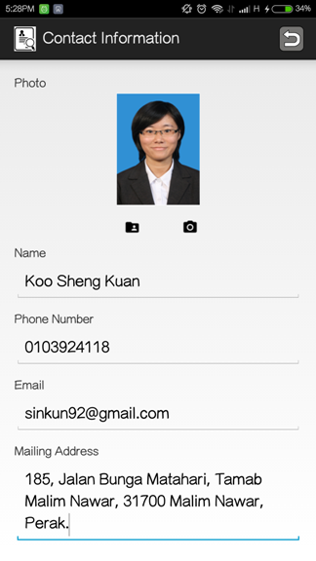
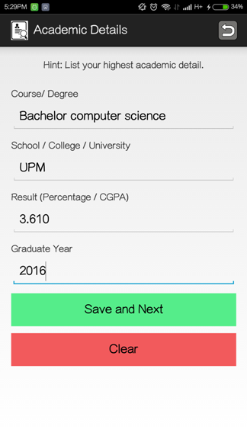
After enter complete contact information, click ‘Save and Next’ to enter next page.
The second page is Academic Detail. Enter your details here!
Click ‘Save and Next’ to next page. Click ‘Clear’ to clear all information.

Slide 11
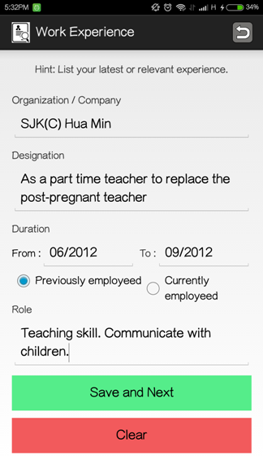
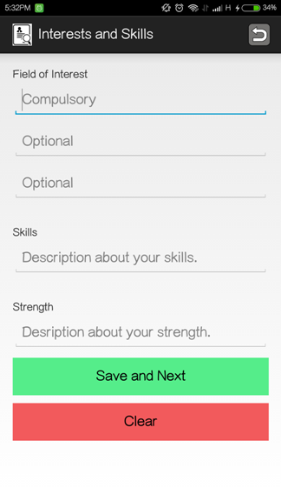
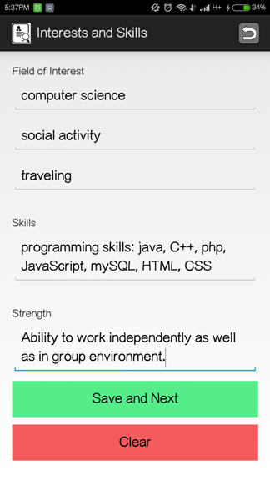
Third page is Working Experience. Enter your work details here!
Some hints are given before you enter the details!
4th page is about your interest and skills.

Slide 12
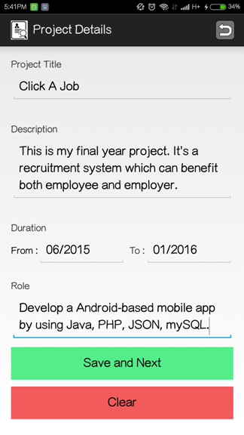
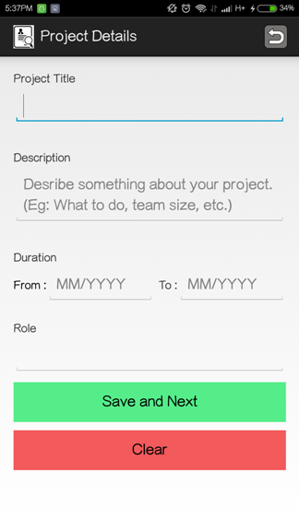
The 5th page is about Project Details.
AFTER
BEFORE

Slide 13
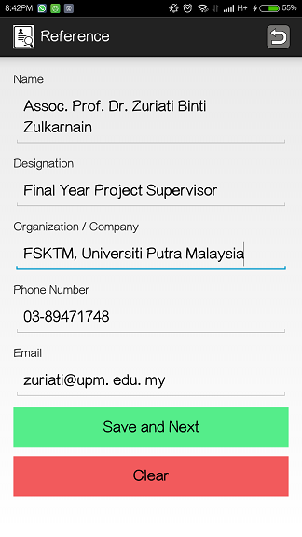
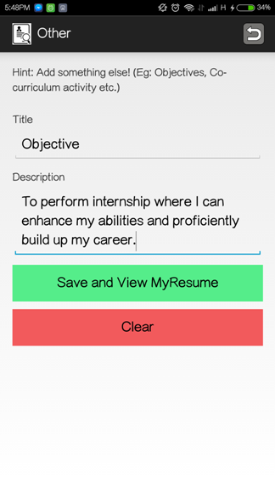
Next, enter your reference details!
Lastly, enter your some other details!
After that, click ‘Save and View MyResume’ here!

Slide 14
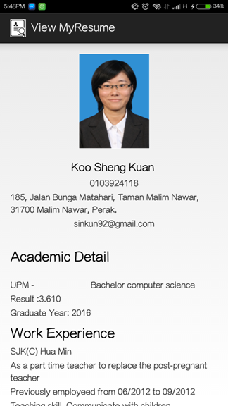
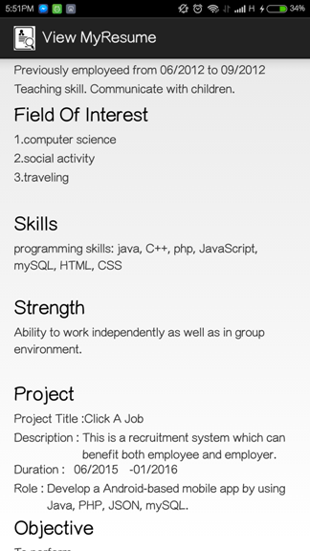
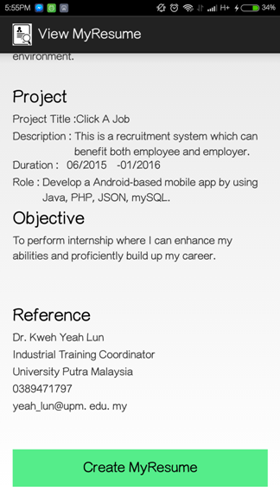
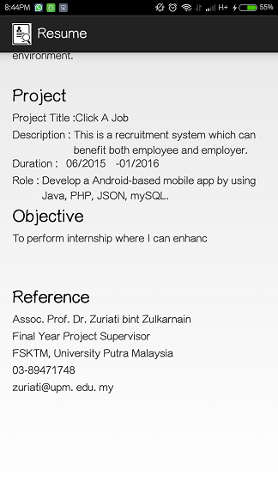
YES!!!
My
Resume had done!!!
The format are simple and fixed.
Now you can create you resume by click here!

Slide 15
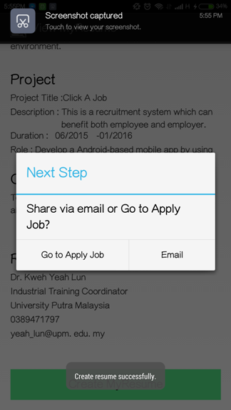
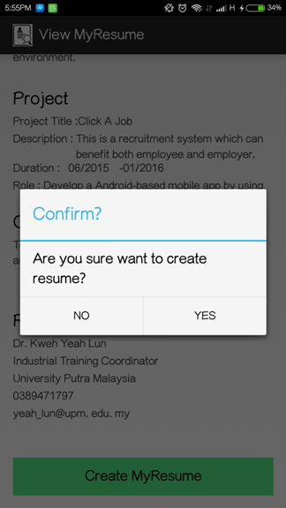
Click ‘YES’ if you confirm to create this resume. Click ‘NO’ and back to page before to edit your details.
After resume had been created, next step is select Email to third party or Go to apply job page.
See!! It shows you that your resume had been created successfully!

Slide 16
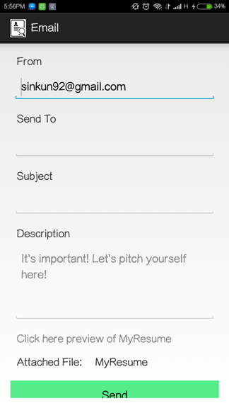
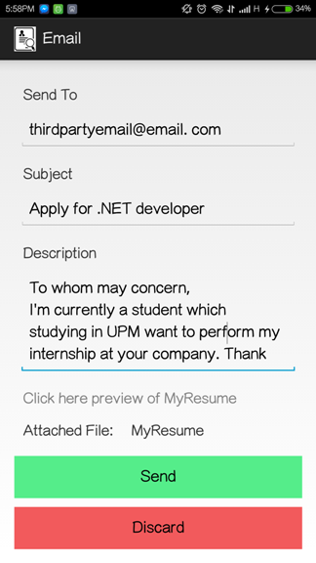
First Choice: Email Resume to Third Party.
Your email address had been the default value to sent the email.
Enter email address that you want send to and pitching about yourself!
Click the attached files to view your resume. If no problem, send it.

Slide 17
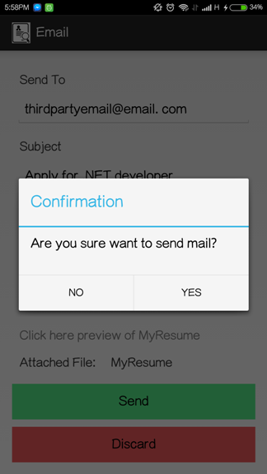
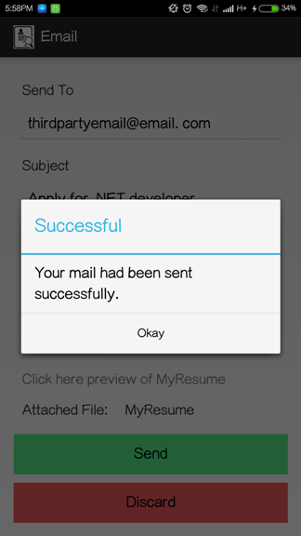
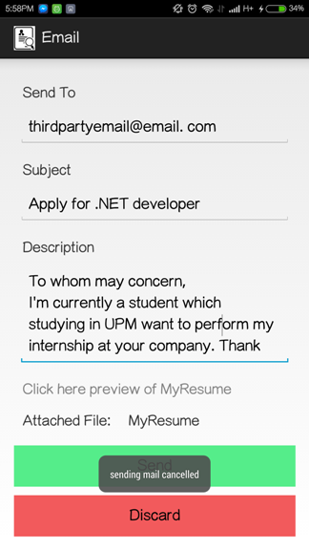
Confirmation to send Email!
If YES, sending mail success!
If NO, sending mail had been cancelled.

Slide 18
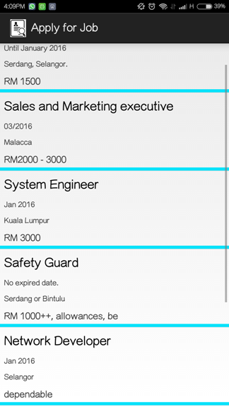
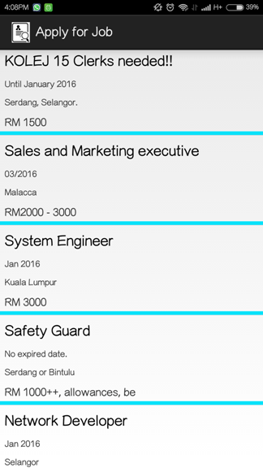
Second Choice: Go to Apply Job.
The list view of a lot of job vacancies.
Details included: Job title, Expired date, Working location and salary.
Can be scrolled down to view more!

Slide 19
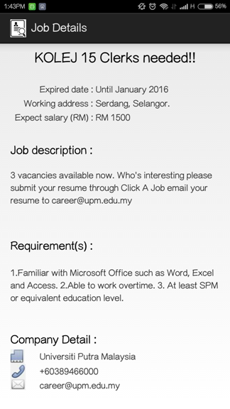
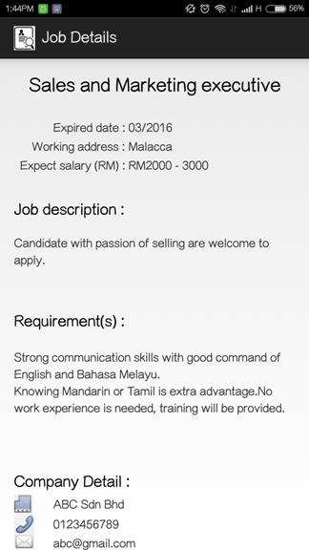
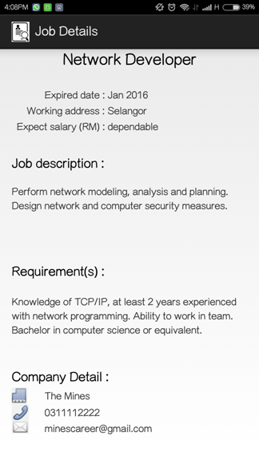
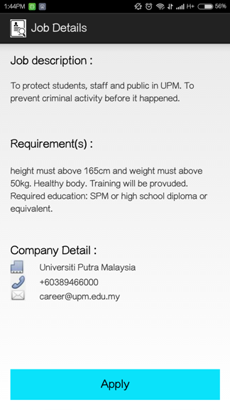
You can view the jobs respectively by clicking each of them.
Click ‘Apply’ here if you’re interesting with this vacancy.

Slide 20
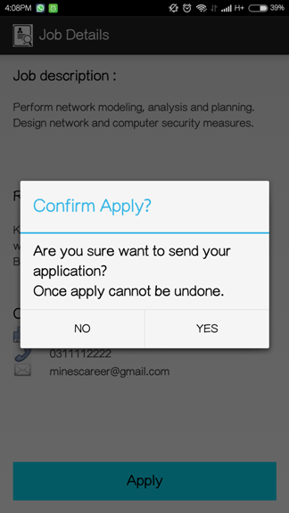
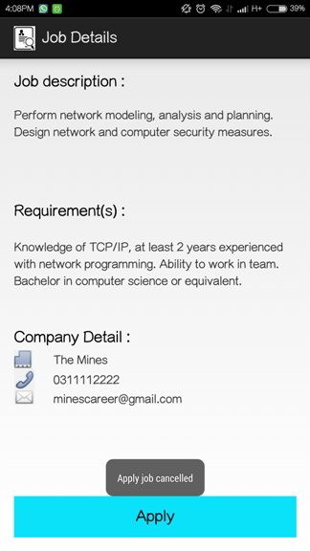
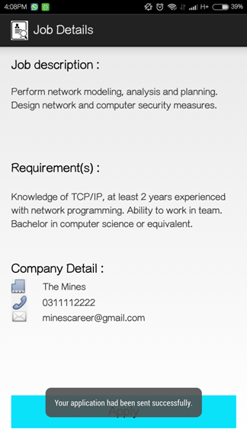
By clicking ‘Apply’, system will ask for confirmation to send your application.
If NO, apply job will be cancelled.
If YES, your application will be sent.
YES!! You have done employee part successfully!!

Slide 21
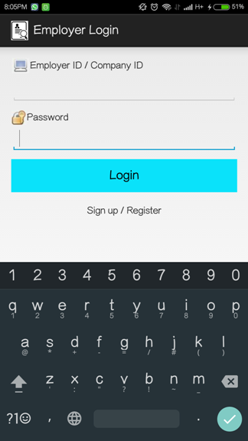
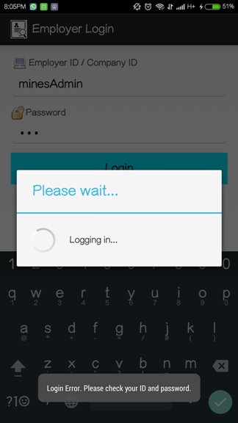
Part 2: Employer
This is the main interface of employer login.
Click to sign up here if employer or company don’t has an account.
When employer login, verification will occur.

Slide 22



Registration of Employer
Employer must have to complete the form.
Employer must agree to our term of service before registration.
Sign up or register interface of employer.

Slide 23


After register successful, it will back to login page and Employer ID and Password will be default with registration just now.
This is the main page of employer. They are able to post job vacancy and view candidates.
After click login, if login successful, it’ll show ‘@employerID, Welcome back!’

Slide 24




The post vacancy interface. Some of the value are default same with registration.
Enter your vacancy detail here!
You can select ‘post’ or ‘discard’ the vacancy here.

Slide 25



If select ‘discard’, system will ask for confirmation to discard the message.
If YES, it will shows ‘Message had been discard’ and back to the previous page which is the main page too.
If NO, it will shows ‘discard cancelled’ and remain same page.

Slide 26




If select ‘Post’, system will ask for confirmation to post the vacancy.
If YES, it will post the vacancy and forward to the next page which can see your post.
If NO, it will shows ‘Post vacancy cancelled’ and remain same page.
Click here to view candidates!

Slide 27


Progress dialog come out to shows candidates are loading.
If there are no candidate apply for this vacancy, it will shows this message.
Otherwise, it will loading the candidate list if there are some candidates applied to this vacancy.

Slide 28



There are the list of candidate apply for this vacancy. You can click respectively to view their resume.

Slide 29




There are some other examples of resume of candidate apply for this vacancy.

Slide 30
After viewing the resume of candidates, employer can call or email to reach and communicate with them according to their details in the resume.
Remember:
A simple click can change your future.
Download ‘Click A Job’ (Android version),
you deserved to a better future.
Thank you.

